Slide 1

MCS and HCM/FIN SaaS Integration
Anirban Bagchi

Slide 2
Idea and Use-Cases
Idea is to show ease of Extending SaaS to build Custom Mobile Applications using Mobile Cloud Service.
Current use-case developed is
Fetch Employees List from HCM
Get Details of particular employee from HCM
Get Details of particular expense from FIN
More use-case definitions in progress
Will be used as internal and customer workshops which will help position MCS for SaaS customers
Will also be used as customer demo’s for MCS and HCM/FIN integration
Notes:
By enriching your CX Cloud with Oracle Cloud PaaS, you can receive the following benefits:
Extend capabilities to create new features and new applications
You get one platform for your entire business with standards based tools that are the most widely used in the industry
Streamlined development with applications portable to other platforms
Some ways your IT folks can enrich your CX cloud today are:
Create mobile apps
Share documents externally on any device
Simplify and unify BI across the business
Use certified 3rd party apps from Oracle Cloud partners
Aggregate data fast with DB Cloud Service, Java Cloud Service
Develop/test fast with DB Cloud Service, Java Cloud Service, Developer Services

Slide 3
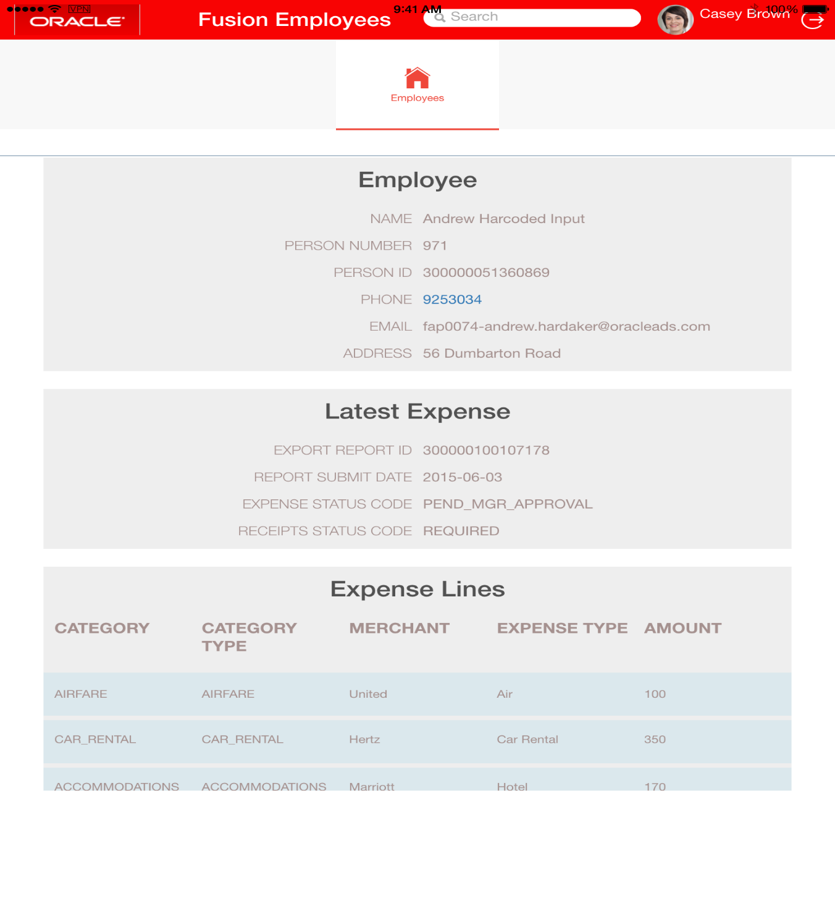
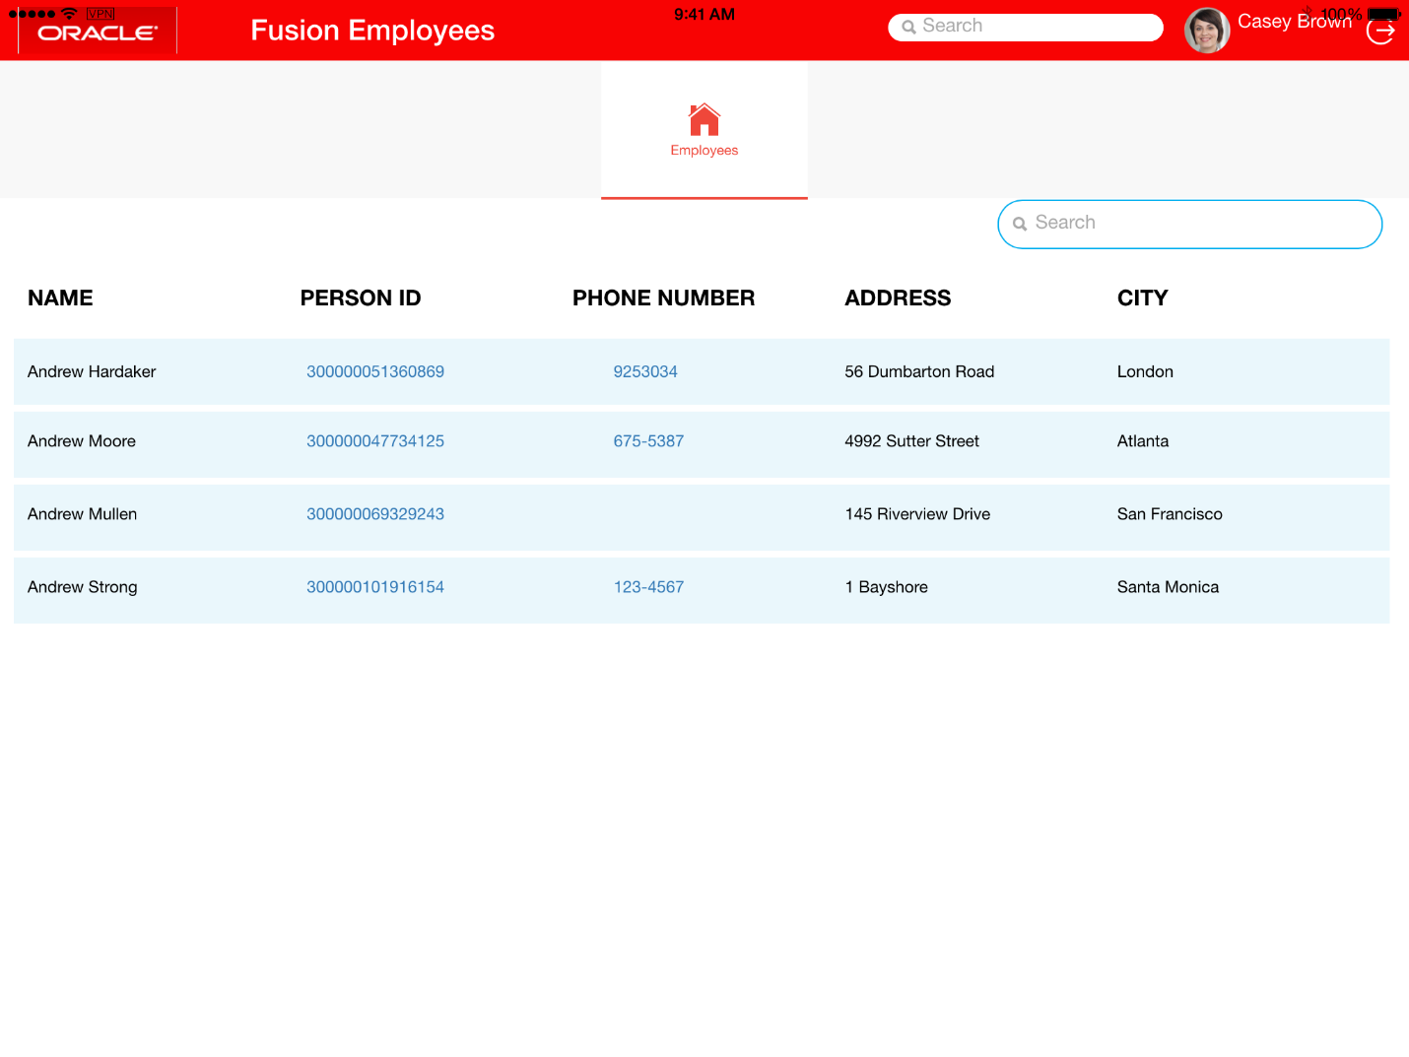
Screenshots of iPad App
Notes:
By enriching your CX Cloud with Oracle Cloud PaaS, you can receive the following benefits:
Extend capabilities to create new features and new applications
You get one platform for your entire business with standards based tools that are the most widely used in the industry
Streamlined development with applications portable to other platforms
Some ways your IT folks can enrich your CX cloud today are:
Create mobile apps
Share documents externally on any device
Simplify and unify BI across the business
Use certified 3rd party apps from Oracle Cloud partners
Aggregate data fast with DB Cloud Service, Java Cloud Service
Develop/test fast with DB Cloud Service, Java Cloud Service, Developer Services

Slide 4
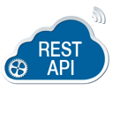
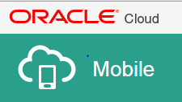
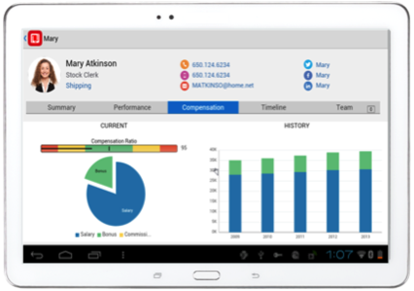
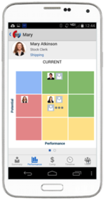







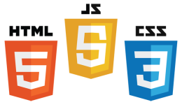
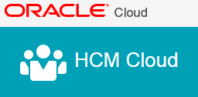
Architecture Diagram
MOBILE APPLICATION FRAMEWORK
GET /employees
GET /employees/{personID}
GET
/expense/{expenseID}
Mobile APIs
Mobile
Cloud Service
Connectors
Others
SECURE
HCM/ FIN CLOUD
Notes:
The Oracle Mobile Service goal is to easily enable mobile application developers that are continually looking for new ways to accelerate development of apps to meet their consumers’ needs. MCS is a set of cloud-based, server-side mobile services to make app development quicker and easier to deploy. MCS reduces the complexities of the application development by dealing with the complex server side programming, reducing the redundancy in creating backend code blocks, providing ready to integrate features and template backend.
Developers can focus more on the front end of the applications and can have their choice of mobile client development tools including ADF-Mobile for cross platform hybrid apps, native development or other Javascript tools – creating a new meaning for BYOD – Bring your own development
MCS provides a set of rich RESTFul interfaces for all the operations required by the mobile app that abstracts the backend from the mobile developer. In addition it also provides mobile specific interfaces for notification (multi channel – app, SMS), offline data sync, persistence services (to store mobile generated data and user preferences) as cloud data storage service.
From a backend perspective, MCS provides all the tools required by API developers to expose and shape the services to be consumed by the mobile developer. This includes mechanisms to design, create and expose these services in a catalog that can be easily and securely discoverable by mobile developers and integrated into their app.
Security is a critical component and is designed ground up in the MCS. From tokens to developers to develop and consume APIs to encryption policies for data in rest, data in motion, policies for single sign on and federated authentication across multiple data sources via Oauth or SAML and policies for defining access rights to applications via mobile application management or container technologies are services that will be available in MCS
A key component of MCS is to provide developers, IT and business with metrics on service usage and business impact. MCS will be designed to provide technical metrics, engagement metrics, business metrics along with the monitoring and management of the service.

